Slide 1
Greek Myths
Using abstraction to tell a modern tale while drawing from the past

Slide 2
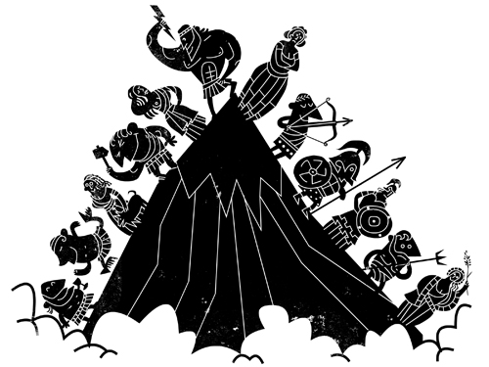
What are Greek Myths?
Religious stories from Ancient Greece about:
Greek gods
Greek heroes
Mythological creatures
The nature of the world
The origins of Greek rituals and traditions
Today, these myths survive both in written stories and in art and pottery

Slide 3
Let’s listen to a famous Greek myth about King Midas… https://www.bbc.co.uk/teach/school-radio/ks2-primary-history-ancient-greece-king-midas-and-the-golden-touch/z4wyhbk

Slide 4
You are going to rewrite a myth… as a modern play!
Your team will:
Choose one of the myths listed on the next slide to read
Read and summarize that myth in one paragraph
Use abstraction to think of a way to modernize the myth, making it about something that could happen today
Write a ~3min play that tells the story of your modern-day myth
Assign roles, rehearse and act out your modern myth

Slide 5
Myth options
Athena and Poseidon compete for a coastal town
King Sisyphus of Corinth tricks Hades
Icarus flies too close to the sun
Persephone and Demeter invent seasons
The fortune teller who speaks in riddles
Apollo and the Trojan Horse
Ares, God of War, and the magical rock
Opening Pandora’s Box

Slide 6
Modernization ideas to get you started
You do not need to pick from this list – these are just examples. Get creative!
A middle school romance
Cheating to pass math test
Trying out for the basketball team
Accidentally Snapchatting your parents
Standing up to the school bully
A fateful trip to Wendy’s

Slide 7
Grading Rubric
 | Doesn’t meet expectations [0] | Approaching expectations [1-4] | Meets expectations [5-8] | Exceeds expectations [9-10]
Myth summary | Summary not completed | Myth was summarized in a single sentence Summary was missing important details | Myth was summarized in paragraph form Summary included some important details | Myth was summarized in a well-structured paragraph Summary included all important details
Modern myth: creativity and effort | Myth not modernized – nothing about the story was changed, or it doesn’t fit in the present day | Myth was changed slightly, but did not show much creativity or effort | Myth was changed to fit somewhat in the present day Modernized myth shows some creativity and effort | Myth was changed to fit very well in the present day Modernized myth is very creative and shows a great deal of effort
Modern myth: script | Script not completed | Script is hard to read Script is not well organized | Script is easy to read and well organized | Script is a professional-looking document that could be performed by any actor
Modern myth: performance | Team refused to perform or had nothing to perform | Team struggles to complete performance Team does not treat their performance seriously | Team completes performance Team treats their performance somewhat seriously | Team completes an entertaining and fun performance while also treating it seriously

